Slide 1
Mathematical Foundation of Machine Learning
I: Introduction and error analysis

Slide 2
Outline
Part I: Deep Learning
ref. book: Ian GoodFellow, Yoshua Benjio, Aaron Conrville – Deep Learning (https://www.deeplearningbook.org/)
Machine Learning Basics, Error Analysis
- basic models, model performance evaluation
Optimization in Deep Learning
- DL models, structure from dynamical system point of view, non-convex optimization
Deep Generative Modeling and Inference
- VAE, Normalizing Flow, GAN, Structured latent variables, self-supervised

Slide 3
Part II: Reinforcement Learning
ref. Book:
Richard S. Sutton, Andrew G. Barto: Refincement Learning:An introduction
Dimitri P. Bertsekas, reinforcement learning and optimal control
Introduction and comparison with optimal control
- Chapter 1 - 3: Introduction and Markov Decision Process
Value Based RL and Policy based RL
- Chapter 4 - 6: Dynamical Programing, Monte Carlo and TD Learning
- Chapter 9 - 11: On-policy, Off-policy, Actor-Critic
Frontiers of RL and Applications
- Connection between optimal control and RL:
- constrained hidden states
- Multi-Agent Deep Reinforcement Learning

Slide 4
Part III: Research directions
Learning stochastic dynamical systems from data
Missing data reconstruction and prediction with applications in NLP, CV, math biology ect.
Learning dynamics：invariant manifolds， bifurcation， chaos
Understand dynamics of neural networks
Nonlocal, Anomaly diffusion, numerial algorithms
You are more than welcome to present !

Slide 5
I. Machine Learning basics, Error Analysis

Slide 6
Outline
Machine Learning Basics
tasks/problems
models
algorithms
Model Evaluation
Research: quantifying generalization error in deep learning
training data size
model compacity
smoothness of Neural Network

Slide 7
Outline
Machine Learning Basics
tasks/problems
models
algorithms
Model Evaluation
Research:
- trade off of large scale learning
- quantifying generalization error in deep learning

Slide 8
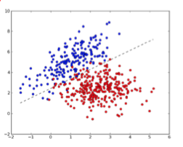
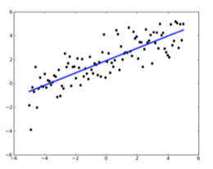
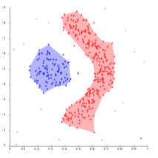
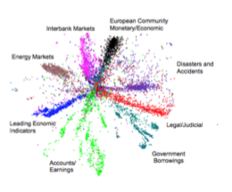
Machine Learning Basics: Tasks
Classification
Regression
Clustering
Dimension reduction

Slide 9
Machine Learning Basics: Models
Tasks | Models
Classification | Logistic Regression, SVM, KNN, | Decision Tree, Random Forest, Adaboost, Gradient Boosting, Neural Network
Regression | Linear, Polynomial,
Clustering | K-means, Hierachy, Density based, Neural Network
Dimension reduction | SVD, PCA, LDA, Neural Network
ML challenges in real applications (to my understanding)
Big Data: high dimension, sparsity
Data Distribution shift over time, Or discrepency btw training vs. predicting;
Catestrophic forgeting and model generalization

Slide 10
Machine Learning Basics: Model
Take Supervised Learning for Example:
Linear regression
Logistic regression
Nueral Network

Slide 11
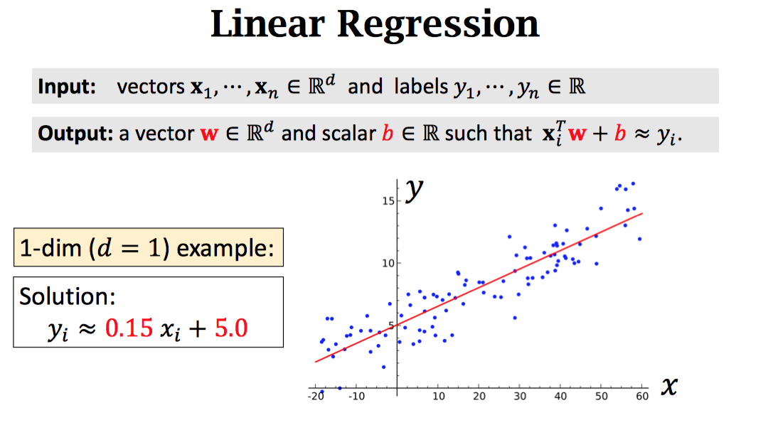

Slide 12
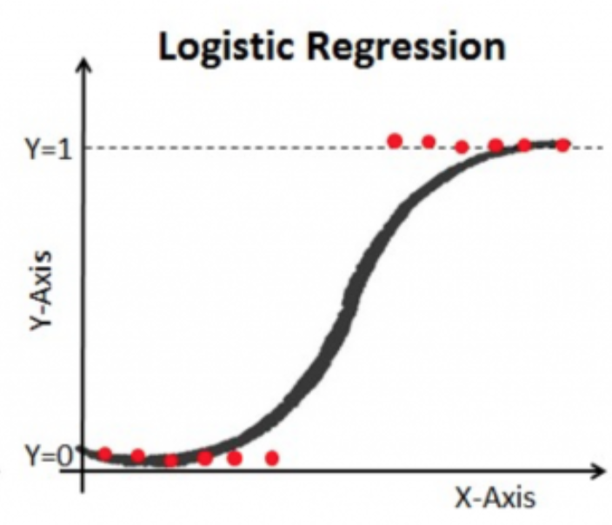
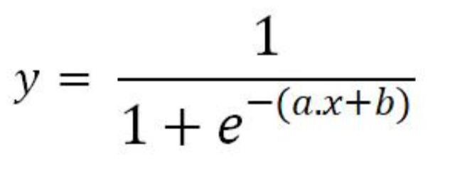
Logistic regression
Binary classification: 1-dim case
Solve: a, b = ?
Sigmoid ?

Slide 13
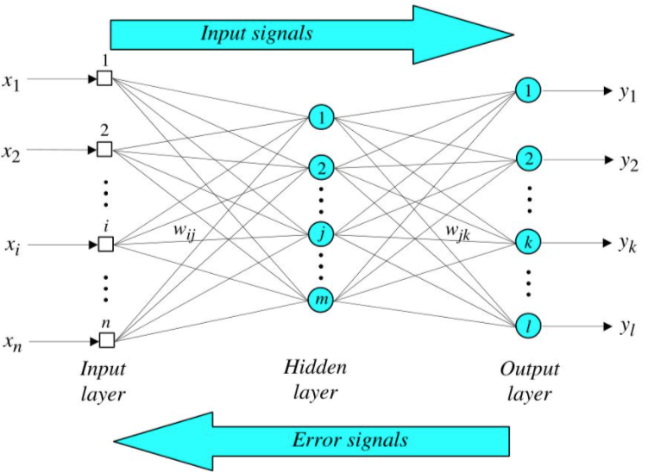
Neural Network
solve: weights w?

Slide 14
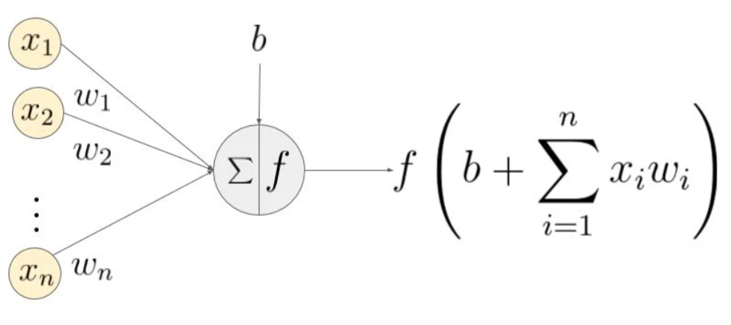
Neural Network
f: activation function

Slide 15
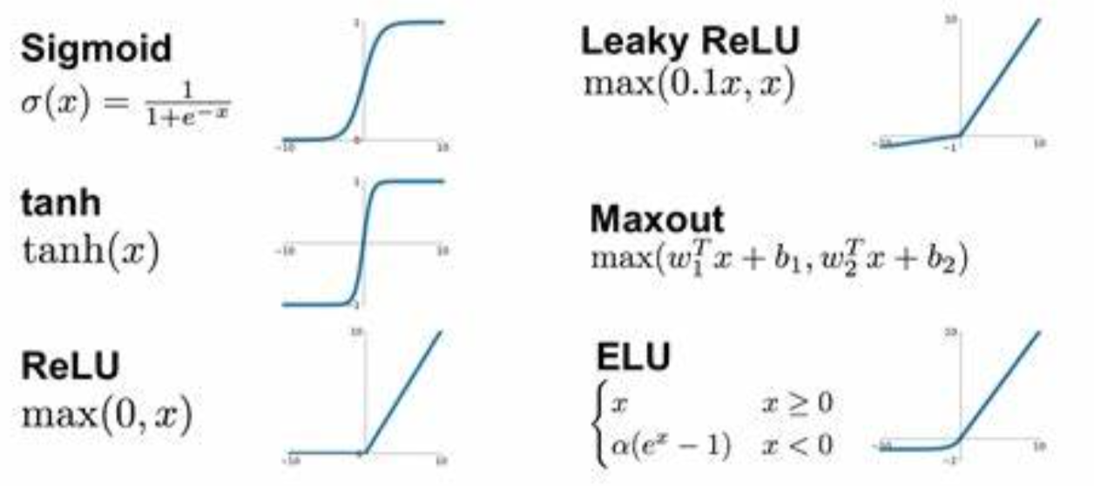
Neural Network
f: activation function

Slide 16


Neural Network
solve: weights w?

Slide 17
Summary:
Task
Data: (X, y)
Goal: find y = f*(x)
Model
define objective function: f(x, w) where w are unknown parameters.
Algorithm
Define loss function: L( f(x, w), y )
Optimization: f*(x) = argmin[ L( f(x, w), y ) ]
W

Slide 18

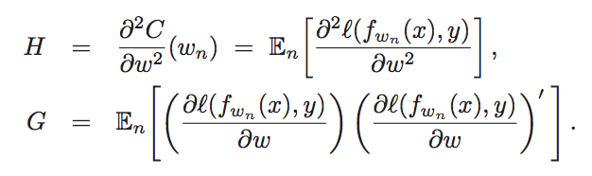
Machine Learning Basics: Algorithms
Assume
is convex and has a single minimum;
the Hessian matrix H and the gradient covariance matrix G, both measured at the empirical optimum.

Slide 19
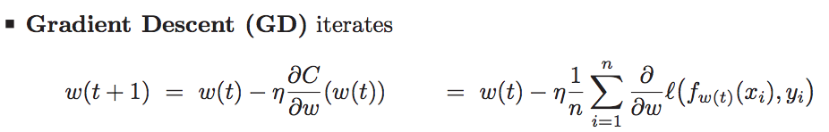
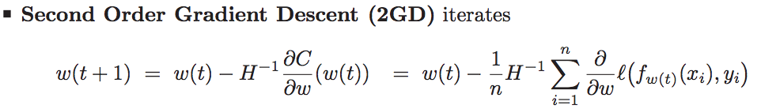
Machine Learning Basics: Algorithms
Stochastic Gradient Descent
Batch training

Slide 20
Recall:
Task
Data: (X, y)
Goal: find y = f*(x)
Model
define objective function: f(x, w) where w are unknown parameters.
Algorithm (next class ...)
Define loss function: L( f(x, w), y )
Optimization: f*(x) = argmin[ L( f(x, w), y ) ]
W

Slide 21
Outline
Machine Learning Basics
tasks/problems
models
algorithms
Model Evaluation
Research:
- trade off of large scale learning
- quantifying generalization error in deep learning

Slide 22
Model Evaluation
- regression: mean squared error
- classification:
accuracy
error rate
precision
Recall
F-score

Slide 23
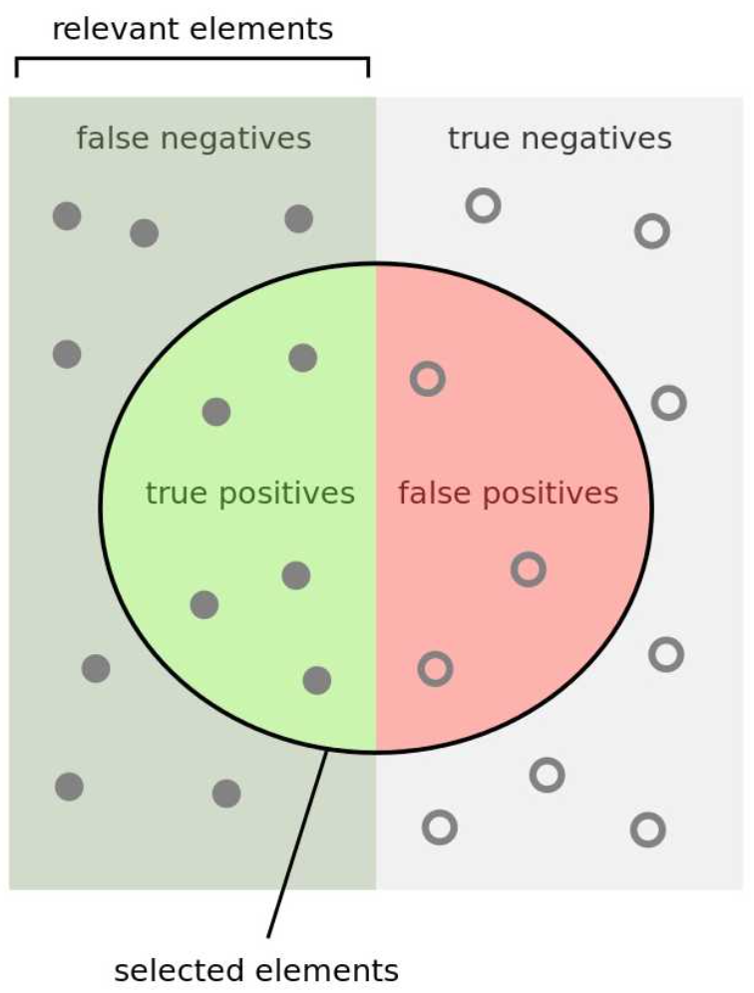
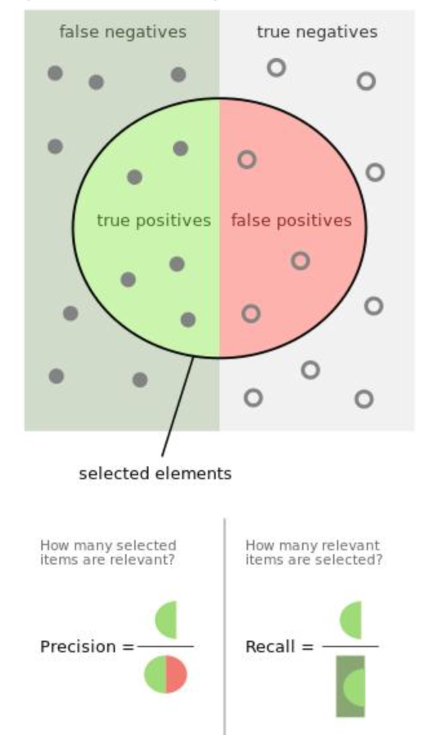
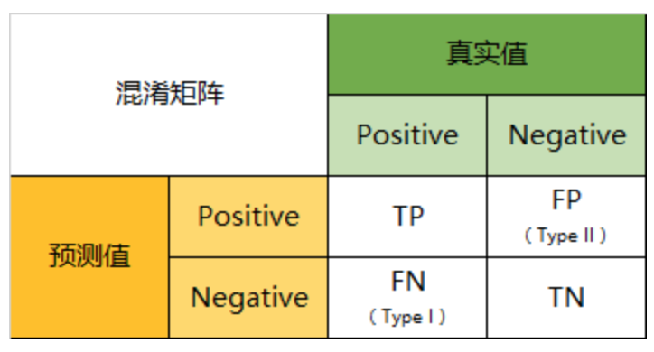
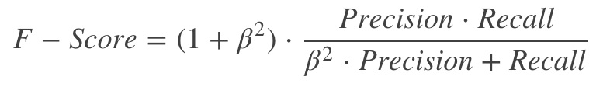
- classification:
accuracy = (TP+TN)/(TP+TN+FP+FN)
error rate = 1- accuracy
precision = TP/(TP+FP)
recall = TP/(TP+FN)
For unbalanced data, different use cases:
e.g. abnormal detection in finance, caner detection - improve recall
search engine - improve precision

Slide 24
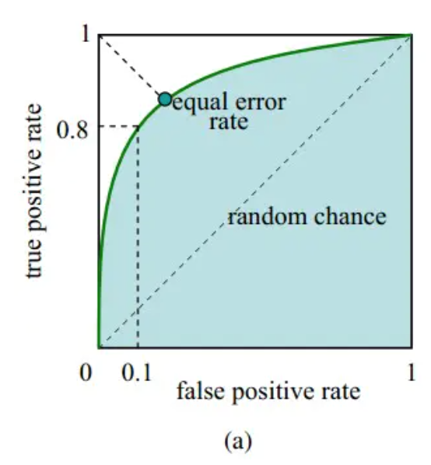
- classification:
ROC, AUC:

Slide 25

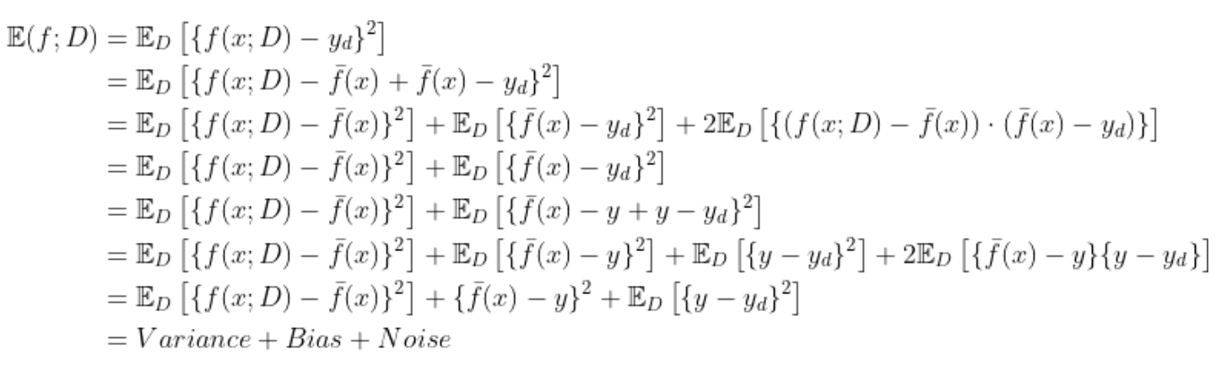
Bias-variance decomposition:
Error: model compacity(algorithm), data size, task difficulty
Machine Learning by Zhihua Zhou, ref. Friedman 2001
Suppose f(x; D) is the prediction result of x on training dataset D,
y is the true label for x and y_d is the label for x in data D, we have training error:

Slide 26
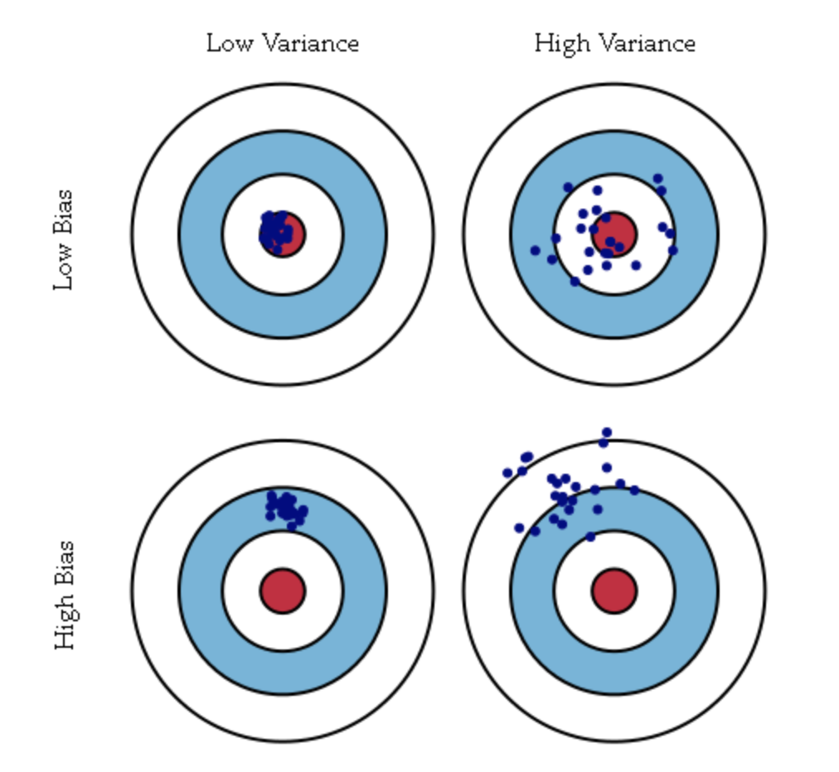
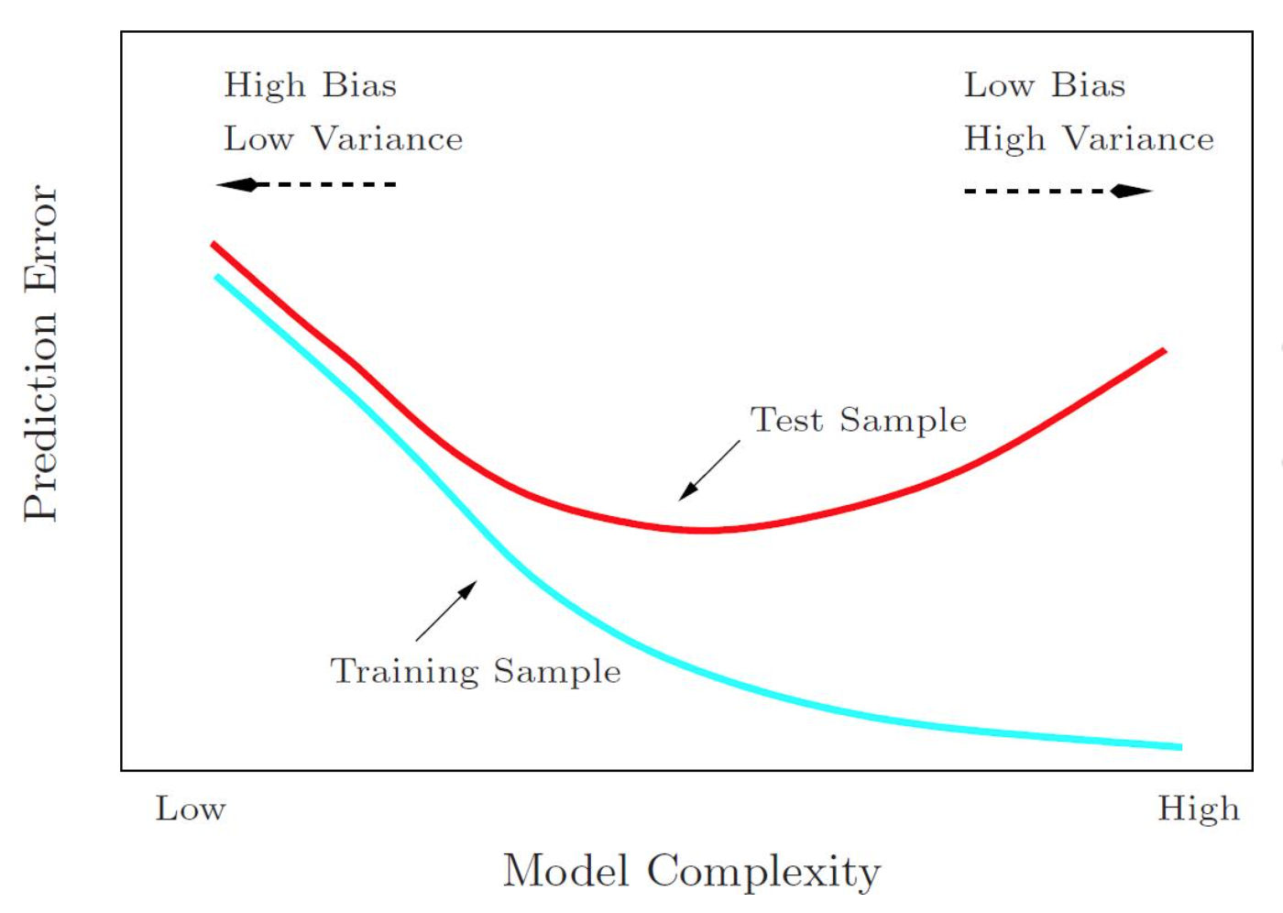
Bias-variance decomposition

Slide 27
Outline
Machine Learning Basics
tasks/problems
models
algorithms
Model Evaluation
Research:
- trade off of large scale learning
- quantifying generalization error in deep learning

Slide 28
Research paper: quantifying generalization error in deep learning
Bottou L, etc. The tradeoffs of Large scale learning (2018 NIPs best)
Jin P, Lu L, etc. Quantifying the generalization error in deep learning in terms of data distribution and neural network smoothness.

Slide 29
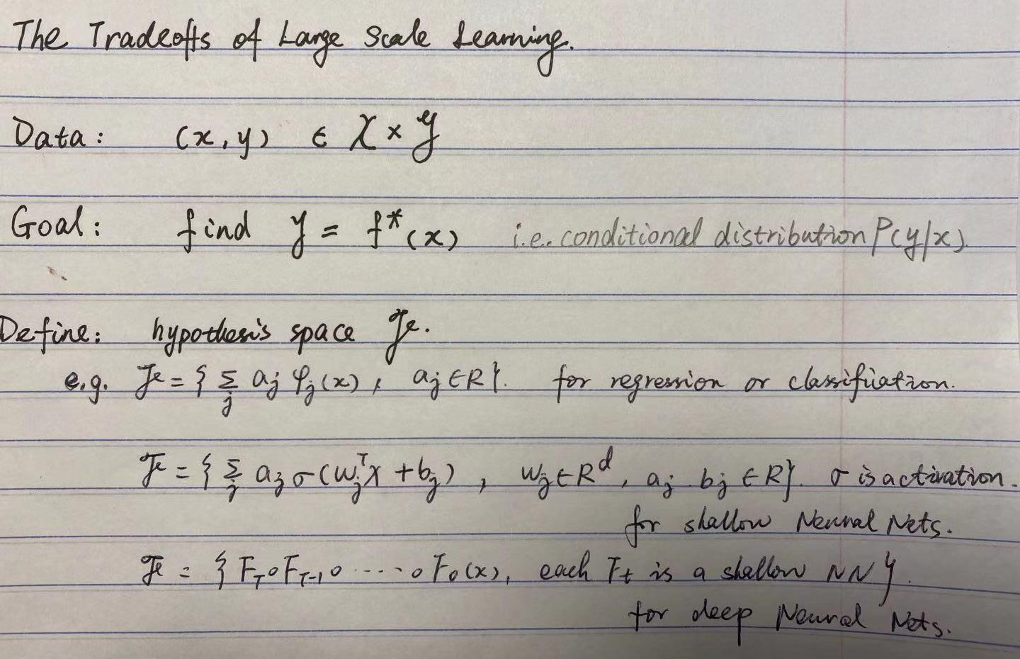

Slide 30
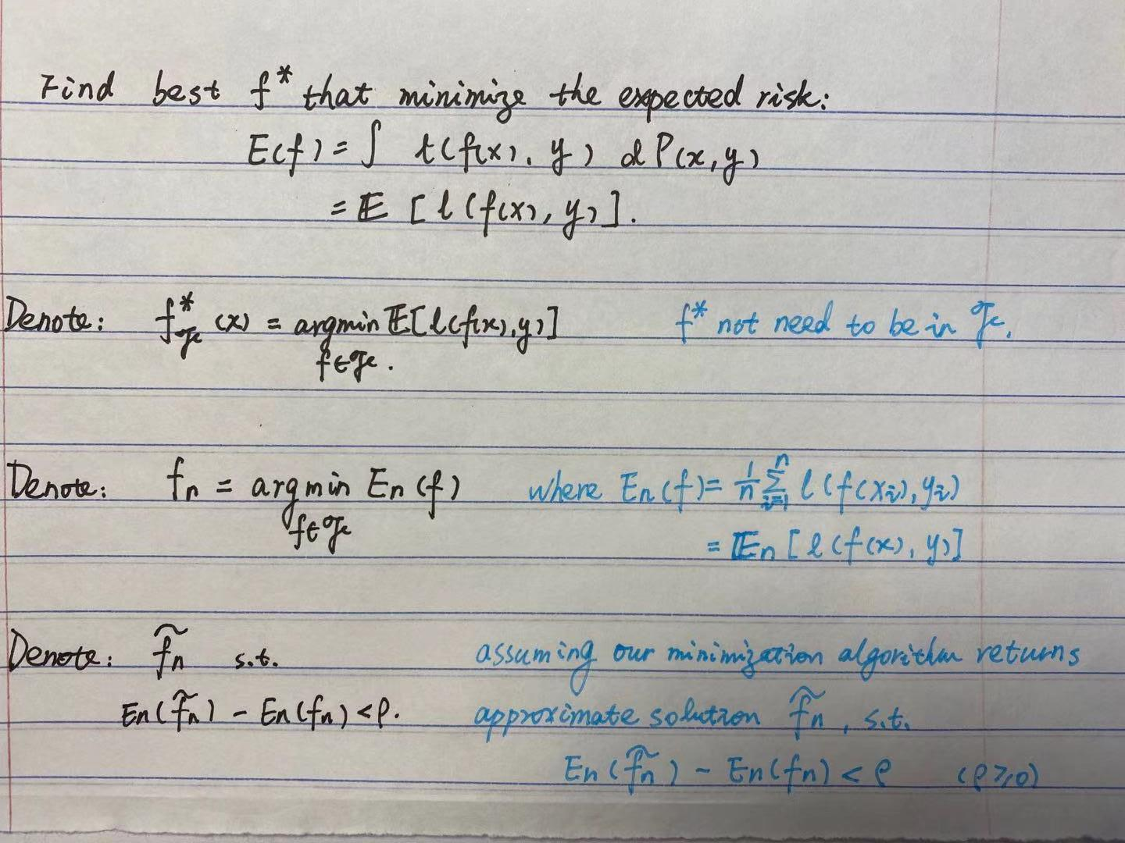

Slide 31
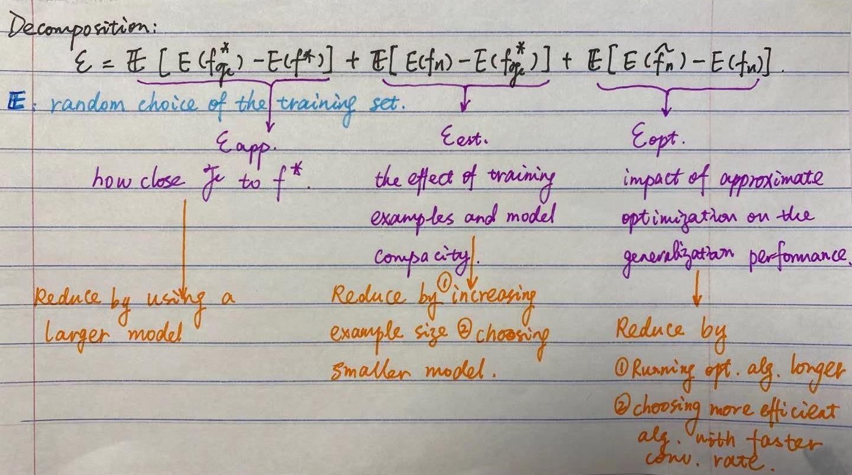

Slide 32
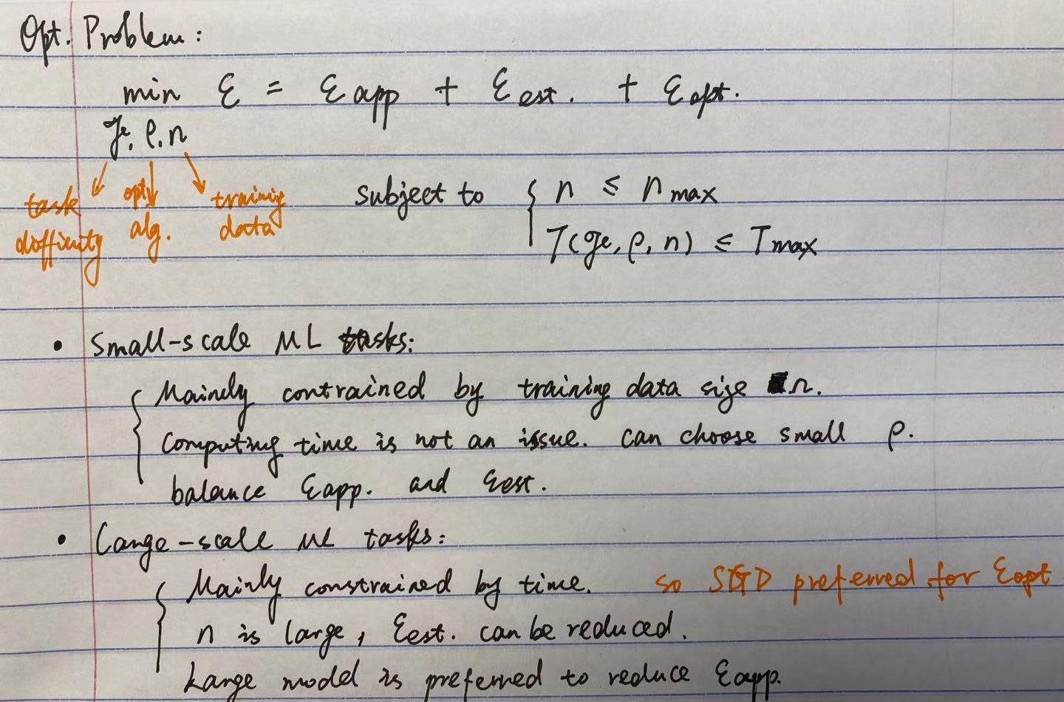

Slide 33
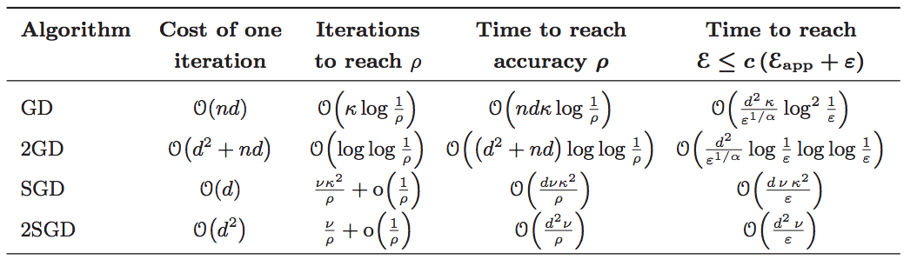
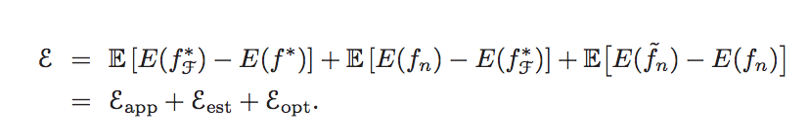
large-scale learning systems:
depends on objective function + computational properties of the chosen optimization algorithm.
SGD and 2SGD results do not depend on the estimation rate α. When the estimation rate is poor, there is less need to optimize accurately, leave time to process more examples.
Stochastic algorithms (SGD, 2SGD) yield the best generalization performance despite showing the worst optimization performance on the empirical cost.
small-scale learning systems:
generalization performance is solely determined by the statistical properties of the objective function

Slide 34
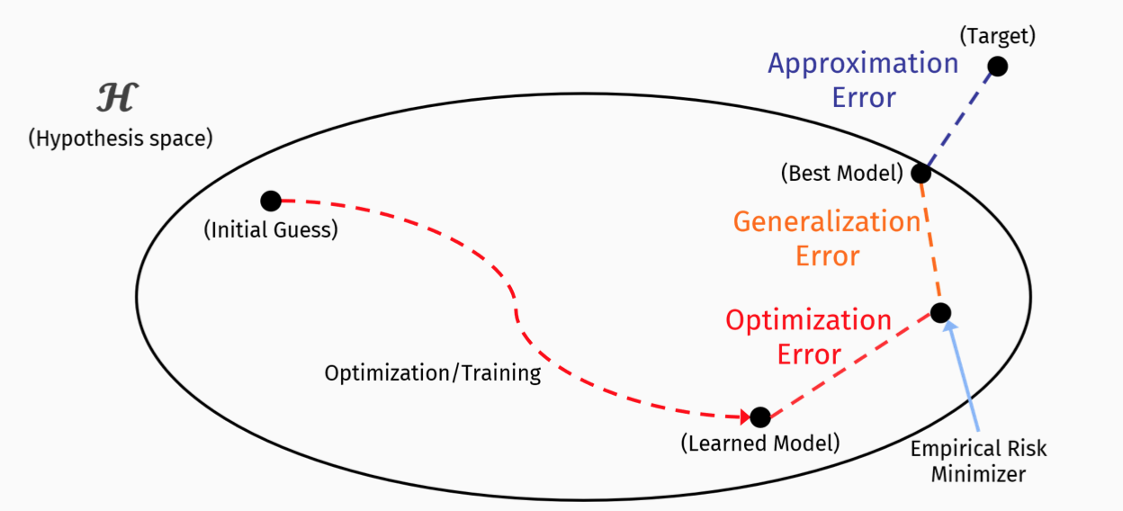
Quantifying the generalization error in deep learning in terms of data distribution and neural network smoothness.
(approximation error, generalization error, optimization error)

Slide 35
Question：
training data
model compacity
smoothness of Neural Network

Slide 36
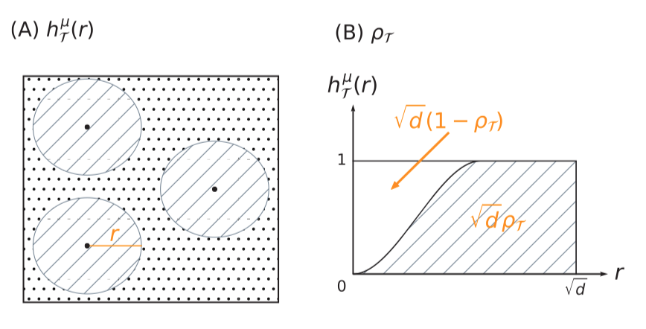

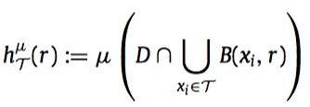

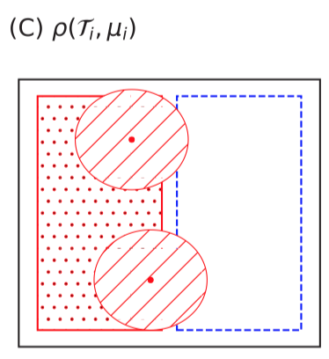
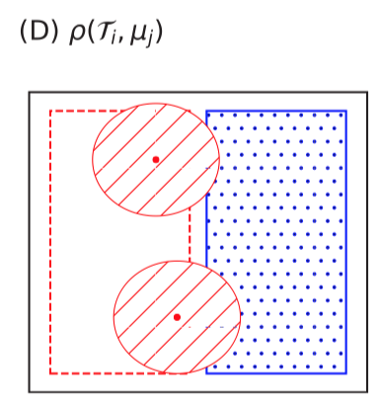


(A) data density
(B)
white area: data sparsity
Data cover complexity:
(1) unchanged with scaled data points, only related to distance between the points;
(2) numerator: the smaller, the better;
(3) denominator: the bigger the better, indicating data under different labels seperated better.

Slide 37
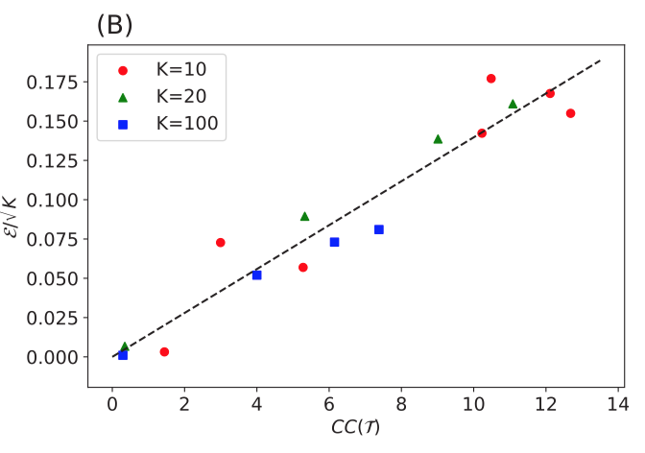
training data
The best accuracy that can be achieved in practice (i.e., optimized by stochastic gradient descent) by fully-connected networks is approximately linear with respect to the cover complexity of the data set.

Slide 38
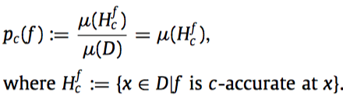

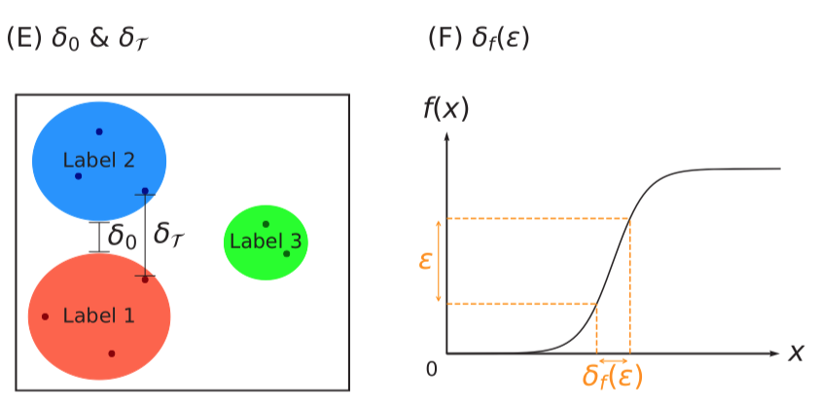

Define: c-Accuracy (smaller than the true accuracy)
second term:
numerator: data sparsity
denominator: smoothness
model compacity

Slide 39
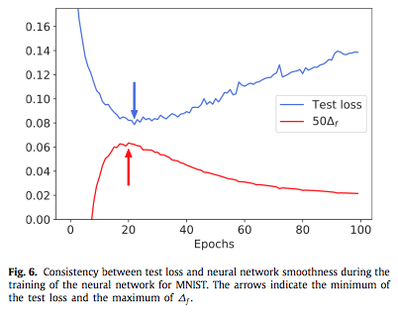
smoothness of Neural Network
The trend of the expected accuracy is consistent with the smoothness of the neural network, which provides a new ‘‘early stopping’’ strategy by monitoring the smoothness of the neural network.

Slide 40
Some Limitations:
1. Assuming setup in multi-class classfication with max predicted component of the result > 0.5.
2. Assuming smoothness of approximation neural network.

